Slide 1
Data Analytics and information virtualization project
Haibo yan

Slide 2
Source - Quality of the datasets(IP#1)
Data Source: Stackoverflow BigQuery Data
Stack Overflow is a question and answer website for professional programmers.
Many experienced programmers spend a lot of time on answering questions, people are honored by their contribution in Stack Overflow(Reliable)
Stack Overflow represents the biggest programmer group in the world. (Representive)
Stack Overflow has great variety coverage on all kind of technologies. Stack Overflow has launched in 2008, it keeps thriving. (High quality)
Stack Overflow has open Data everyone can access and it keeps updated.(Accessible)

Slide 3
Motivation - Quality of the problem (IP#1)
What’s interested me are
what's the technology is hottest in the computer science world right now
what's the trend,
what could be next important technology.
How's the technologies trend affected by geography and why there is geography effect.

Slide 4
ETL strategy and procedures(IP#2)
Using a python program sampling 10K data to csv files
Import data to Tableau Prep, change all date time type and remove most of null value
Convert id as string
Split tags into multiple keywords
Group posts by different keywords
Union a couple of tags number
Group post by year based
Output result to a csv file

Slide 5
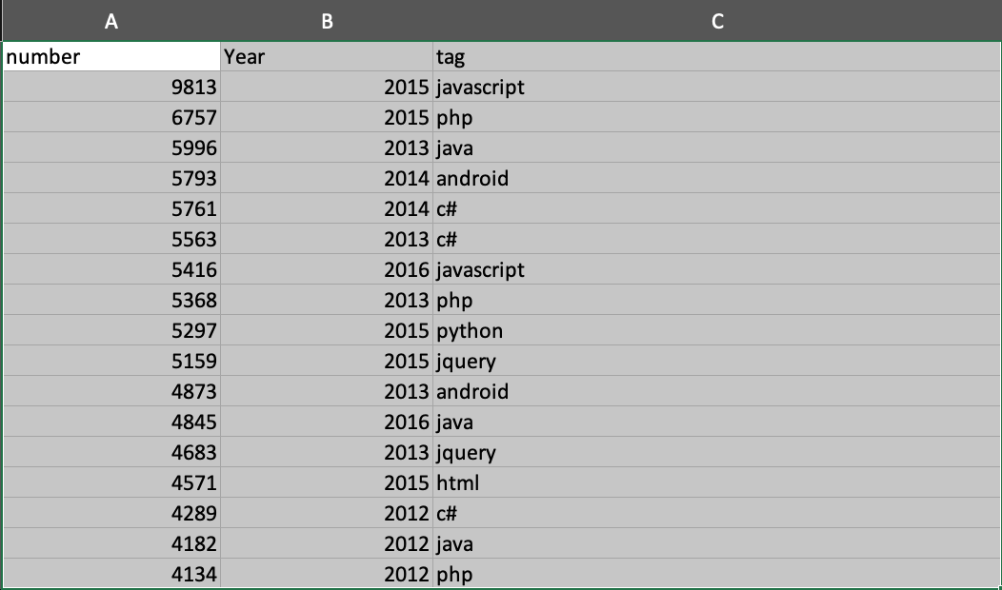
Results (IP#2)

Slide 6
Quality (IP#2)
Top 100 technologies are well known
Covered year 2008 to year 2018
Some years seems missing
TODO:
Using bigger sample rate to check if we can find missing year data

Slide 7
Descriptive Statistics - Analysis (IP#3)
Data
Tag – Categorical Type
Year - Categorical Type
Number – Quantitative Type
Analysis
Population – Mean, Median, Mode
Number more than 100 – Mean, Median, Mode
Population - Range, Variance, Standard Deviation, Coefficient of Variation
Number more than 100 - Range, Variance, Standard Deviation, Coefficient of Variation
Covariance/Correlation between top 10 tag

Slide 8
Descriptive Statistics - Conclusion (IP#3)
Population data is not accurate, it’s more meaning ful number is greater than 100(Median of population is 2, and mean is 12, range is 9812)
Some year some technology become very popular. Eg .net is popular at from year 2011 to year 2014, javascript at year 2017 to year 2018
Technology usage like C/C++ are related

Slide 9
Descriptive Data Mining (IP#4)
Question Defined
Cluster user based their community behavior
User Table
reputation – quantitative
up_votes - quantitative
down_votes - quantitative
views - quantitative
Analysis
Based on user’s reputation, and up votes, down votes and views for their answers or comments, group the user.
Expected user could be grouped to very popular user, high involvement user and regular user
K-Means is adopted to the dataset, normalized column since range of 4 columns are huge

Slide 10
Descriptive Data Mining - Conclusion (IP#4)
Result
users.xlsx
Analysis
Cluster 1 – High Reputation, very involved user
Cluster 2 – Very involved user, much more positive feedback on up votes
Cluster 3 – Regular User

Slide 11
Linear Regression(IP#5)
Question Defined
Analyze StackOverflow Score System
Independent Variables
days(post keep alive days) – quantitative
comment_count- quantitative
answer_count- quantitative
view_count - quantitative
favorite_count - quantitative
Dependent Variables
score - quantitative

Slide 12
Simple Linear Regression(IP#5)
As relevance analysis, most effective independent variable is favorite count
R Square is 86.51%, prove assumption that favorite_count can affect score a lot.
P-value is 8.5E-219, which is much smaller than 0.5
Estimated Regression Equation: score = 4.18 * favorite_count – 6.71
SUMMARY OUTPUT
Regression Statistics
Multiple R | 0.930127
R Square | 0.865136
Adjusted R Square | 0.864866
Standard Error | 53.14987
Observations | 500
ANOVA
 | df | SS | MS | F | Significance F
Regression | 1 | 9024502 | 9024502 | 3194.618 | 8.5E-219
Residual | 498 | 1406804 | 2824.908
Total | 499 | 10431307
 | Coefficients | Standard Error | t Stat | P-value | Lower 95% | Upper 95% | Lower 99.0% | Upper 99.0%
Intercept | -6.7114 | 2.461892 | -2.72612 | 0.006634 | -11.5484 | -1.87443 | -13.0772 | -0.3456
favorite_count | 4.179862 | 0.073952 | 56.52095 | 8.5E-219 | 4.034565 | 4.325159 | 3.98864 | 4.371084

Slide 13
Multiple Linear Regression(IP#5)
By using forward selection, rule out comment_count and view count
As relevance analysis, most effective independent variable is favorite count
R Square is 87.90%
All P-values are smaller than 0.5
SUMMARY OUTPUT
Regression Statistics
Multiple R | 0.937565364
R Square | 0.879028812
Adjusted R Square | 0.878297132
Standard Error | 50.43935098
Observations | 500
ANOVA
 | df | SS | MS | F | Significance F
Regression | 3 | 9169419 | 3056473 | 1201.383 | 5.3E-227
Residual | 496 | 1261888 | 2544.128
Total | 499 | 10431307
 | Coefficients | Standard Error | t Stat | P-value | Lower 95% | Upper 95% | Lower 99.0% | Upper 99.0%
Intercept | 14.07820065 | 3.865983 | 3.641558 | 0.000299 | 6.482479 | 21.67392 | 4.081629 | 24.07477
DAYS | -0.001950801 | 0.002573 | -0.75804 | 0.448788 | -0.00701 | 0.003105 | -0.00861 | 0.004704
answer_count | -5.8742352 | 0.853153 | -6.88533 | 1.75E-11 | -7.55047 | -4.198 | -8.0803 | -3.66817
favorite_count | 4.607011309 | 0.090243 | 51.051 | 1.4E-199 | 4.429705 | 4.784318 | 4.373662 | 4.84036

Slide 14
Linear Regression - multicollinearity (IP#5)
By using Quadratic Regression Models R square can be improved to 97.88%
By validation by other data, this model is not overfitting
SUMMARY OUTPUT
Regression Statistics
Multiple R | 0.989360117
R Square | 0.978833441
Adjusted R Square | 0.978662398
Standard Error | 21.11990126
Observations | 500
ANOVA
 | df | SS | MS | F | Significance F
Regression | 4 | 10210512 | 2552628 | 5722.737 | 0
Residual | 495 | 220794.9 | 446.0502
Total | 499 | 10431307
 | Coefficients | Standard Error | t Stat | P-value | Lower 95% | Upper 95% | Lower 99.0% | Upper 99.0%
Intercept | 8.830625282 | 1.622399 | 5.442942 | 8.26E-08 | 5.642987 | 12.01826 | 4.635428 | 13.02582
DAYS | 0.005736056 | 0.001089 | 5.266059 | 2.08E-07 | 0.003596 | 0.007876 | 0.002919 | 0.008553
answer_count | 0.314223121 | 0.379502 | 0.827987 | 0.408077 | -0.43141 | 1.059857 | -0.66709 | 1.29554
favorite_count | 0.640664946 | 0.090377 | 7.088776 | 4.69E-12 | 0.463094 | 0.818236 | 0.406967 | 0.874363
favorite_count sq | 0.00716329 | 0.000148 | 48.31176 | 1.7E-189 | 0.006872 | 0.007455 | 0.00678 | 0.007547

Slide 15
Linear Regression - Conclusion(IP#5)
Result
questions_score.xlsx
Analysis
favorite_count is most effective independent variable
By adding answer_count to model, can improve accuracy, but not too much

Slide 16
Predictive Data Analytics(IP#6)
Question Defined
According to tag.xsl, we know most tagged topic is javascript, we’re going to analyze how accurate this tag
Analysis
In IP#2, we know that javascript has been tagged as most mentioned word in all posts
For all the post, we only analysis the title by using either bag of word or word2vec get word vector, also the category will be 1 when tag contains javascript and 9 when it doesn’t contain javascript

Slide 17
Data Preparation(IP#6)
The data we got from big query is sampling data.
As the dataset we have is 10K data, we would use 60% as training set, 20% as validation set and 20% as test set.
The code for converting title to vector is here.
For simplicity, here only use scikit-lean’s bag of words(specific HashingVectorizer) because we have very big corpus also the title is free style.
There are other choice like one-hot or tfidi. This is just a example.

Slide 18
Data Preparation(IP#6) – Logistic Regression
Result

Slide 19
Predictive Data Analytics(IP#6) – KNN

Slide 20
Predictive Data Analytics(IP#6) – Conclusion

Slide 21
Links
Code: https://github.com/billyean/anna
https://learning.oreilly.com/library/view/applied-text-analysis/9781491963036/ch04.html

